Slide 1

StockWatch
ATLS 5214: Big Data Architecture

Slide 2




Team Members:

Slide 3

Table of contents
01
05
02
06
03
07
04
Project Overview
Learning Curve
Tools and Technologies
Challenges
Architecture Diagram
Future Scope
Demo

Slide 4
Project Overview
Big data pipeline that collects twitter data pertinent to various stocks.
Analytic framework for performing user sentiment analysis on various trending stocks.
Correlation between user sentiments and stock price

Slide 5
Tools & Technologies
Yahoo Finance API and Twitter API for Data
Kafka for Data Ingestion
PySpark for Data Processing
MongoDb for Data Store
Streamlit for Frontend
Python for Backend
AWS for Deployment
Github for Version Control & Collaboration
Notion for Project Management
VSCode for IDE

Slide 6
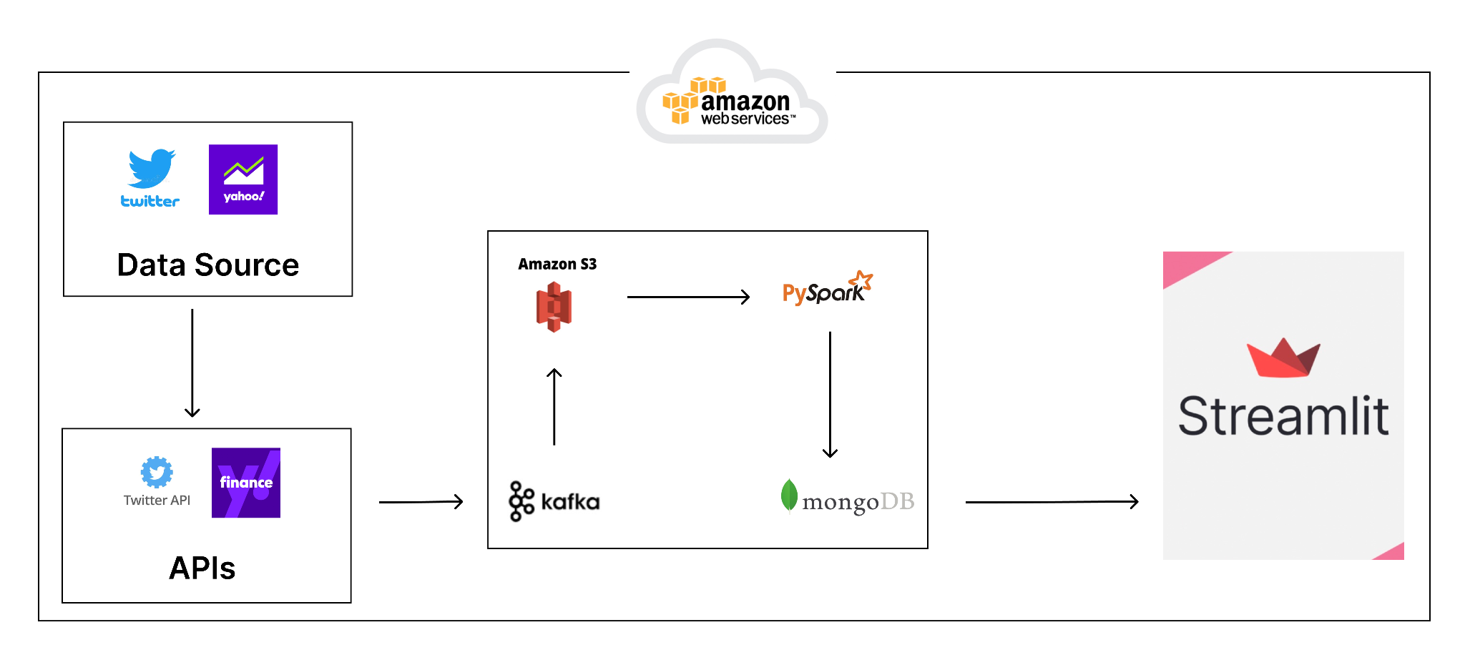
Architecture Diagram

Slide 7
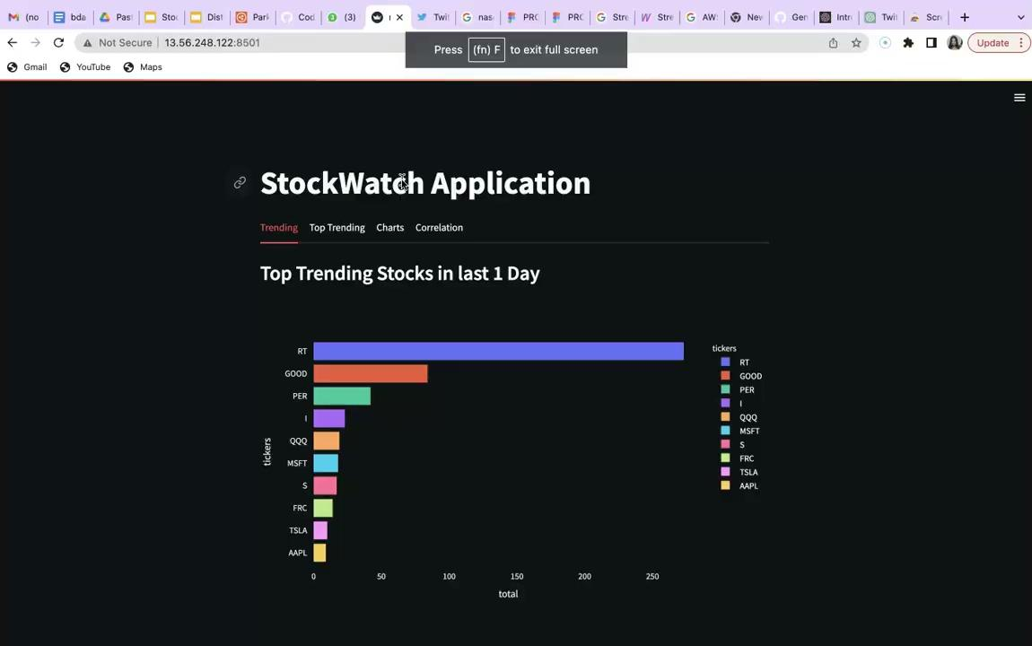
Demo
http://13.56.248.122:8501/
Demo Link

Slide 8
Learning Curve
Efficient data pipeline to handle real time big data.
Learning new technologies like Kafka, PySpark, Streamlit.
Understanding communication between various pipeline components and integrating them together.
Deciding what data fields to use and how to visualize them in a user friendly way .
Deployment on Amazon Web Services.
Working in the AGILE methodology.

Slide 9

Challenges
New Technologies
Integrating Kafka
Hosting and deployment
Understanding Stock Market Dynamics

Slide 10

Future Scope
Predicting Stock Prices Using LSTM
Predicting a Bear or bull market
Recommendation
Containerization
Exploring other API’s

Slide 11

Thank you!

